Slide 1
AngularJS
Custom Directives
Lecture 1
By James(Jin) Wang
08/08/2019

Slide 2
Outline
The Role of Directives
Creating a Hello World Directive
Directive Categories
Directive Building Blocks

Slide 3

The Role of Directives
  What are Directives?
  Markers on a DOM element that tell AngularJS’s HTML compiler($compile) to attach a specified behavior to that DOM element…

Slide 4
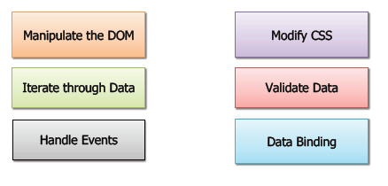
The Role of Directives
  What can Directives do?

Slide 5
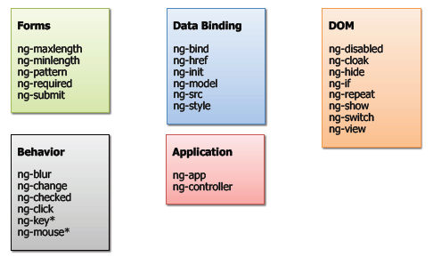
The Role of Directives
  Key AngularJS Directives

Slide 6
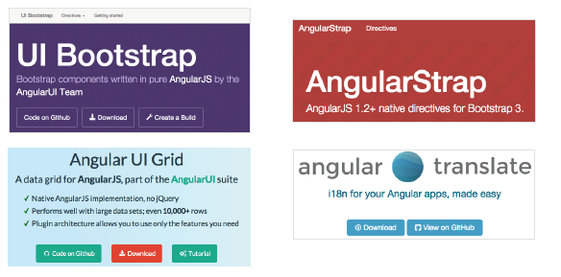
The Role of Directives
  3rd Party Directives

Slide 7
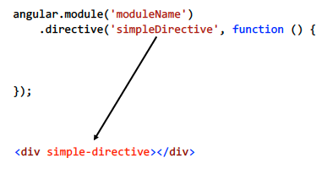
Defining and Using a Directive

Slide 8
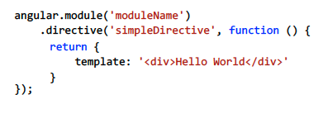
Defining and Using a Directive

Slide 9
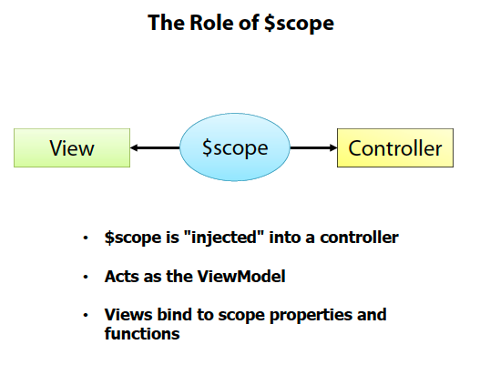
Controller, Scope and Modules

Slide 10
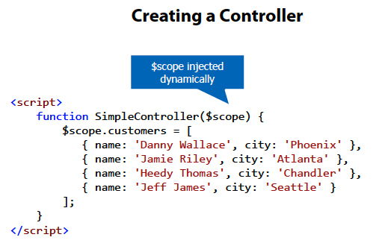
Controller, Scope and Modules

Slide 11
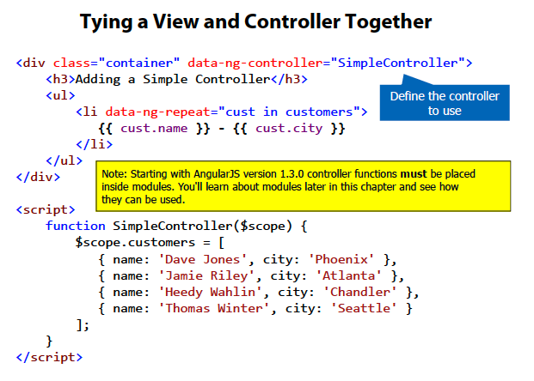
Controller, Scope and Modules
  The ng-controller Directive:

Slide 12
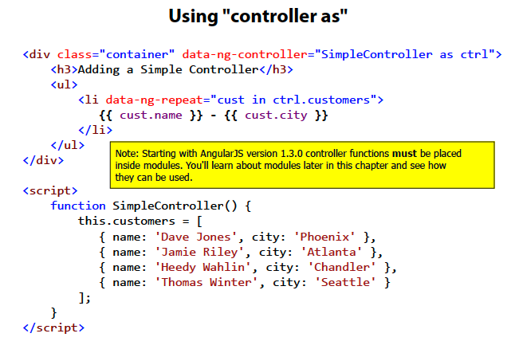
Controller, Scope and Modules

Slide 13
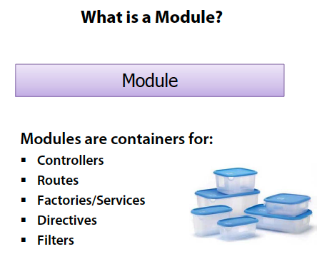
Controller, Scope and Modules
  The Role of Modules:

Slide 14
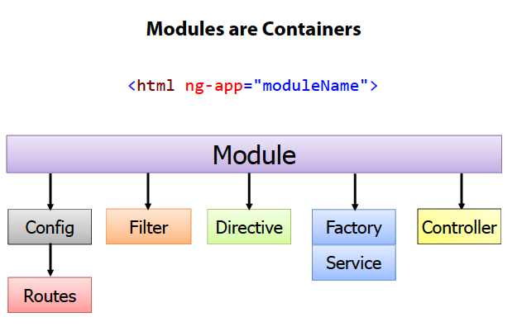
Controller, Scope and Modules

Slide 15
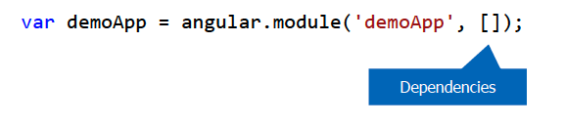
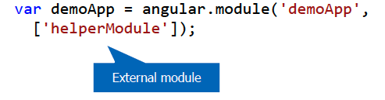
Controller, Scope and Modules
  Defining a Module:
  Create a module using angular.module():
  Injecting Dependencies into a Module:
  Modules may rely on functionality from other modules
  Helper modules can be “injected” into a module:

Slide 16
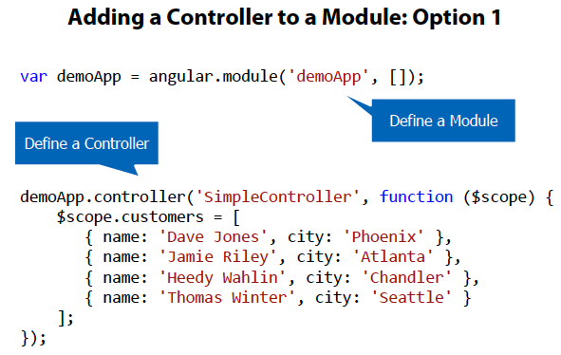
Controller, Scope and Modules
  Adding a Controller to a Module:

Slide 17
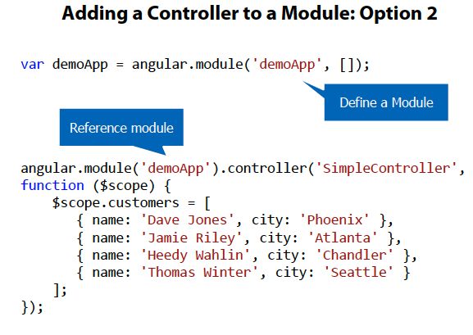
Controller, Scope and Modules

Slide 18
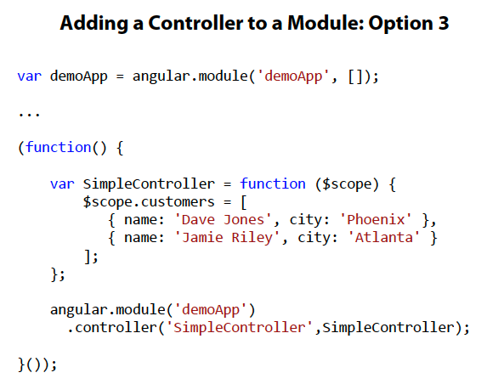
Controller, Scope and Modules

Slide 19
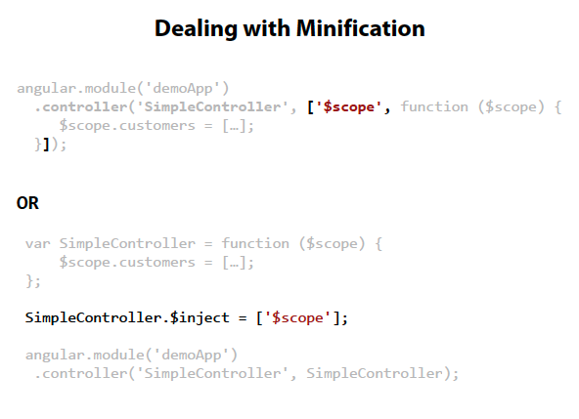
Controller, Scope and Modules

Slide 20
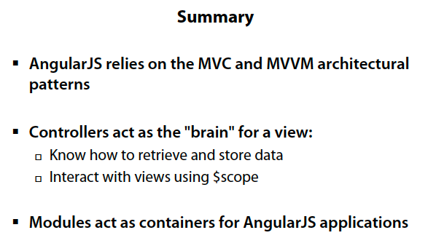
Controller, Scope and Modules

